Slide 1
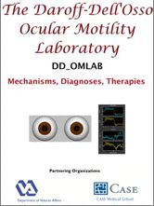


E.2 CANINE VIDEOS:
Videos of Dogs, Cat, and Goat
L.F. Dell'Osso
Daroff-Dell’Osso Ocular Motility Laboratory
CASE Medical School and Louis Stokes Cleveland DVA Medical Center
Department of Neurology
Case Western Reserve University, Cleveland, OH

Slide 2

CV1 Normal Brittany

Slide 3
CV2 Achiasma Pre-T&R

Slide 4
CV3 Achiasma Post-T&R

Slide 5
CV4 RPE65- Pre-Gene Therapy Behavior

Slide 6
CV5 RPE65- Post-Gene Therapy Behavior

Slide 7
CV6 RPE65- Pre-Gene Therapy

Slide 8
CV7 RPE65- Post-Gene Therapy

Slide 9
CV8 Cat with INS

Slide 10
CV9 Goat with SSN

